Slide 1

Spotify Most Streamed Songs in 2024 Analysis
Presentation By: Daniel Buddington

Slide 2
Why Spotify?
The topic was selected based on a couple viral occurrences happening close to each other such as:
2024 Spotify Wrapped
Drake vs Kendrick Lamar Beef
Drake v. Universal Music Group
The data set was chosen due to its Kaggle usability rating of 10, having 29.5K downloads, and fitting the requirement criteria.
My interest in this topic comes from my daily music listening and use of Spotify as my music streaming service for years. In my wrapped I had over 60,000 minutes and 1,900 unique artists listened to.

Slide 3



DATA sources
It was easy finding data sources and articles relating to the topic because Spotify is a large mainstream business.
I had to ensure I chose articles that were unbiased about Spotify, Kendrick, and Drake to draw meaningful conclusions.
“Drake takes legal action over Kendrick Lamar’s Not Like Us” – Mark Savage, BBC News
“Spotify Wrapped 2024: Backlash, Controversy And Memes” – Dani Di Placido, Forbes

Slide 4
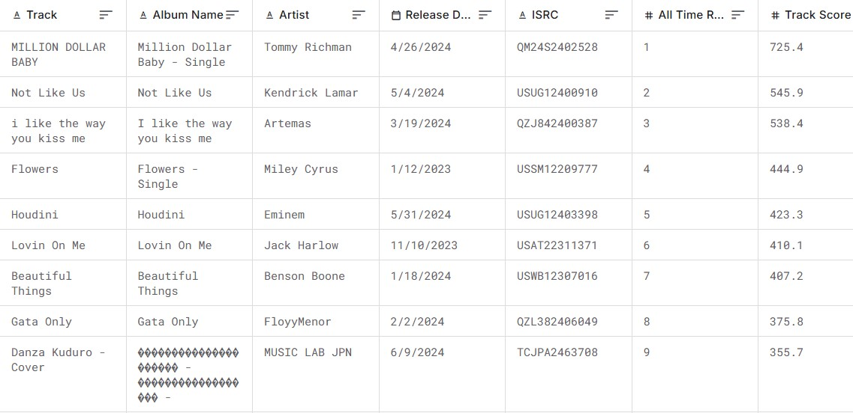
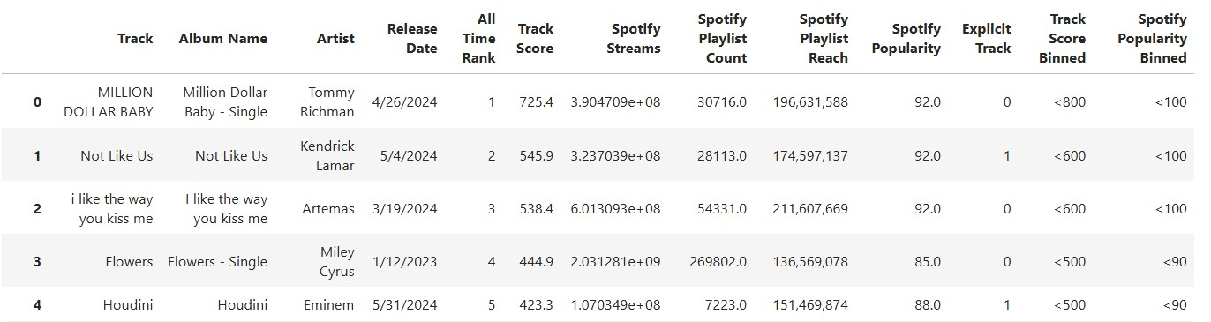

Data Wrangling

Slide 5
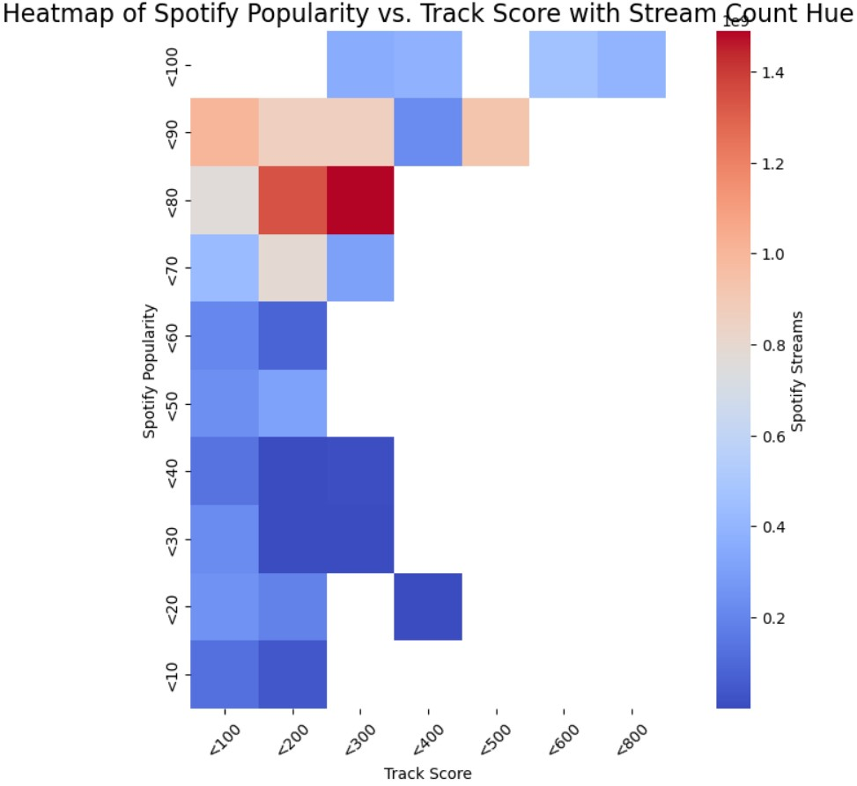
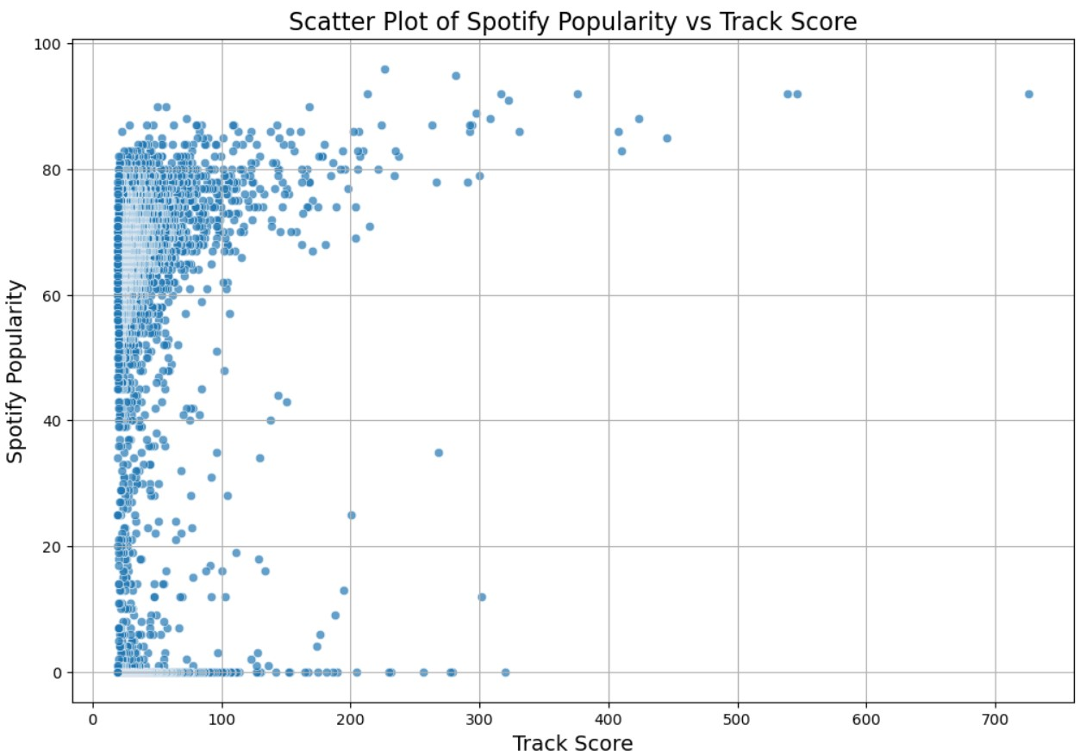
Data Distribution & Data Binning

Slide 6
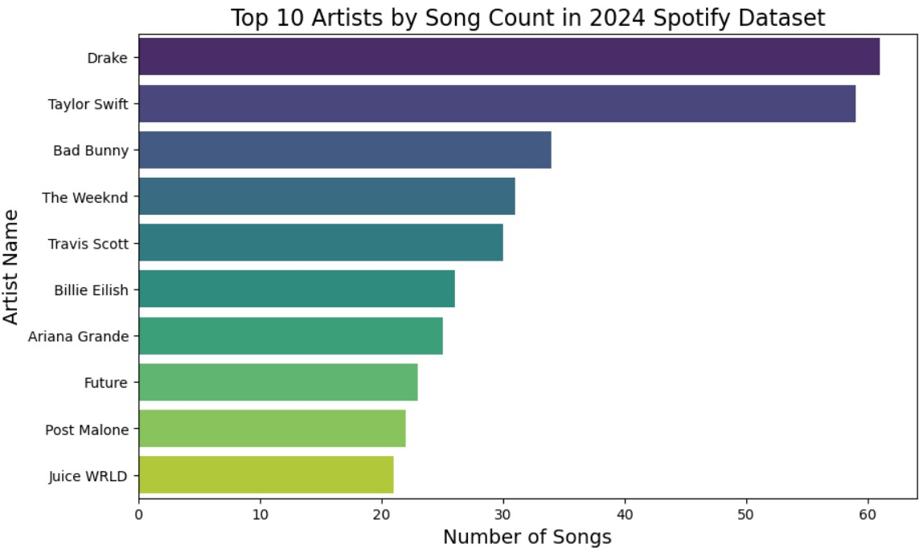
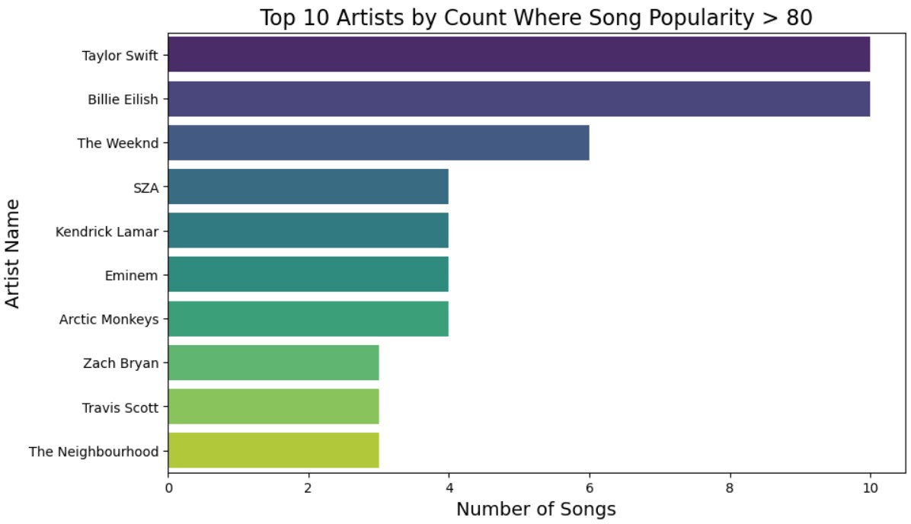
Top artist and popularity score

Slide 7
Most common words that appeared in each article
Most common words in the “Drake takes legal action over Kendrick Lamar’s Not Like Us” article:
drake: 12
universal: 9
lamar: 6
legal: 5
music: 5
Most common words in the “Spotify Wrapped 2024: Backlash, Controversy And Memes” article:
spotify: 18
wrapped: 12
listeners: 10
year: 7
ai: 6

Slide 8
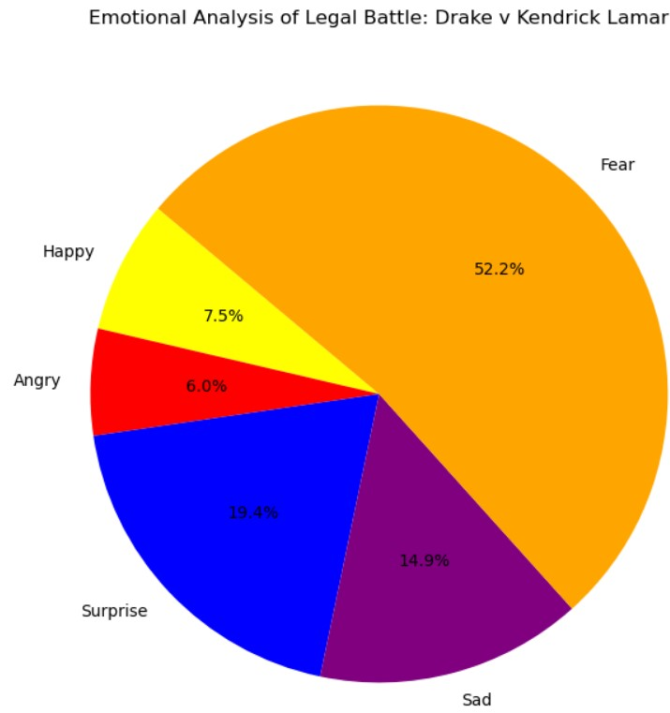
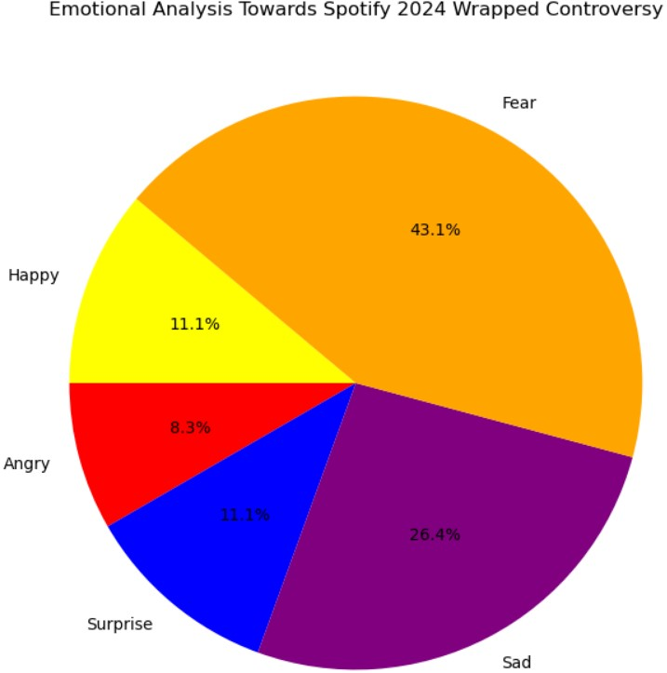
Sentiment of each article

Slide 9
conclusions
In conclusion it is evident most streamed song count density is denser around the popularity rating data point of 80 meaning the more views your streams it has the more likely it is to be more popular, but more streams does not contribute to a better track score.
While Drake had more songs that made it into the dataset to be conferred as a most streamed, Kendrick’s songs within the same dataset achieved a higher popularity rating which equated to a vastly higher streams.
Issues experienced during analysis:
Transformation of the data due to foreign characters and symbols present within artist, track and album names.
Remaining without bias in producing figures.
Ensuring all web article elements were properly scrapped and cleaned in ETL process.

